Slide 1
Twitter Sentiment Analysis
Text Mining and Deep Learning

Slide 2
Presentation Outline
Defining the Problem
Describing the Dataset
Preprocessing
BERT
Findings
Code
Future Works

Slide 3
Defining the Problem
Sentiment classification is an important process in understanding people’s perception towards a product, service, or topic.
Twitter gets on average:
6,000 tweets per second,
350,000 tweets per minute,
21,000,000 tweets per hour,
500,000,000 tweets per day,
200,000,000,000 tweets per year!
So much wasted data.
How to solve this issue?
Solution based on the paper called “Fine-grained Sentiment Classification using BERT”

Slide 4
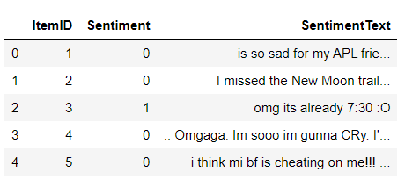
Describing the Dataset
We have used the Twitter Sentiment Analysis dataset from Kaggle (reference: https://www.kaggle.com/c/twitter-sentiment-analysis2/data).
It has 99,989 of skewed data.
It has 3 columns: ItemID, Sentiment, SentimentText.

Slide 5
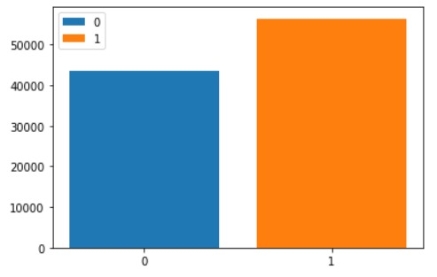
Describing the Dataset
56,457 (or 56.46%) negative perception.
43,532 (or 43.54%) positive perception.
We have balanced data.

Slide 6
Preprocessing
Canonicalization: Remove all the digits, punctuation symbols and accent marks, and convert everything to lowercase.
Special token addition: Add in the [CLS] and [SEP] tokens at appropriate positions.
Tokenization: Tokenize the text using the WordPiece tokenizer.

Slide 7
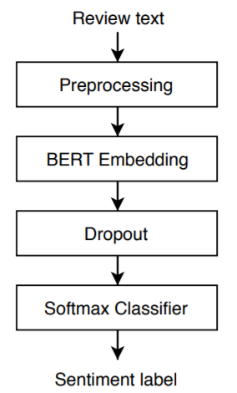
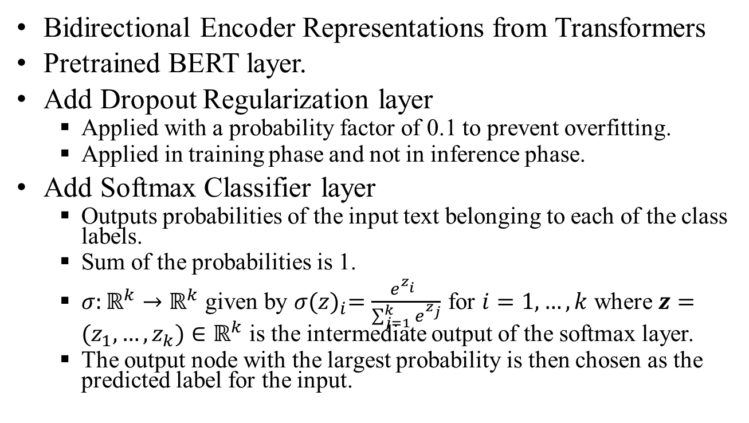
BERT
Bidirectional Encoder Representations from Transformers
Pretrained BERT layer.
Add Dropout Regularization layer
Applied with a probability factor of 0.1 to prevent overfitting.
Applied in training phase and not in inference phase.
Add Softmax Classifier layer
Outputs probabilities of the input text belonging to each of the class labels.
Sum of the probabilities is 1.
$σ:ℝ^{k}→ℝ^{k}$ given by $σ{(z)}_{i}=\frac{e^{z_{i}^{}}}{\sum_{j=1}^{k}{e^{z_{j}}}}$ for $i=1, …, k$ where $z=(z_{1},…,z_{k})∈ℝ^{k}$ is the intermediate output of the softmax layer.
The output node with the largest probability is then chosen as the predicted label for the input.
(0,1)

Slide 8

Findings
With only 2 epochs we got the following results:
30 Epochs would take:
30 hours (1.25 days) on a GPU,
90 hours (3.75 days) on a CPU!
Final result in the paper is 94.7%.

Slide 9
Code

Slide 10
Future Works
Implement XLNet instead of BERT.
Balance the dataset.
Switch from Binary Sentiment Classification to Fine-Grained Sentiment Classification.
Train for 30 epochs.

Slide 11
References
M. Munikar et al. 2019, “Fine-grained Sentiment Classification using BERT,” arXiv preprint, arXiv:1910.03474v1 (https://arxiv.org/pdf/1910.03474.pdf)

